Slide 1
Course – DBMS
Course Instructor
Dr. K. Subrahmanyam
Department of CSE

Slide 2
Instruction to Students
Apart from the contents presented in the slides students should read through the text book also.

Slide 3
Topics Covered in Todays Class
Unit 2:
Introduction to Relational Algebra

Slide 4
Why you should Learn “Relational Algebra” ?

Slide 5
Why you should Learn “Relational Algebra” ?
Relational Algebra is
Core of Relational Query Language, Example: SQL
Provides framework for Query implementation and optimization
Is a mathematical language for manipulating relations.

Slide 6

Relational Algebra based on Relational Model
student_info
Won Turing award 1981
USN | Name
1BM14CS001 | Arjun
1BM14CS002 | Balaji
Relational model due to Edgar Teds Codd,
a mathematician at IBM in 1970

Slide 7
Relational Algebra based on Relational Model
student_info
Won Turing award 1981
USN | Name
1BM14CS001 | Arjun
1BM14CS002 | Balaji
Relational model due to Edgar “Ted” Codd,
a mathematician at IBM in 1970
Column or Attribute
Row
or
Tuple
or
Record
USN | Name
1BM14CS001 | Arjun
1BM14CS002 | Balaji
Table
or
Relation
Database table Name: student_info

Slide 8
RDBMS Architecture
Relational Database Management System (RDBMS)
How does a SQL engine work ?
SQL Query
Relational Algebra (RA) Plan
Optimized RA Plan
Execution
Declarative query (from user)
Find logically equivalent- but more efficient- RA expression
Execute each operator of the optimized plan!
Translate to relational algebra expression

Slide 9
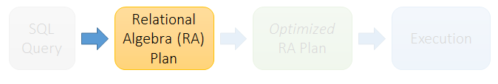
RDBMS Architecture
Relational Database Management System (RDBMS)
How does a SQL engine work ?
Relational Algebra allows us to translate declarative (SQL) queries
into precise and optimizable expressions!

Slide 10
What is an “Algebra”
Mathematical system consisting of:
Operands: variables or values from which new values can be constructed.
Operators: symbols denoting procedures that construct new values from given values.

Slide 11
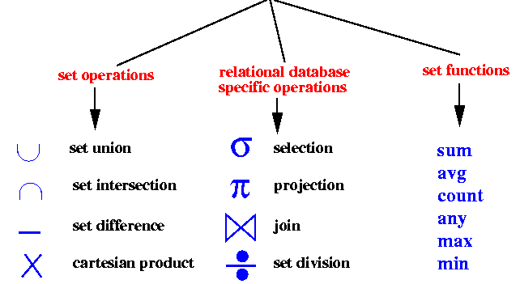
What is Relational Algebra (RA) ?
An algebra whose operands are database tables or relations or variables that represent relations.
Operators are designed to do the most common things that we need to do with relations in a database.
The result is an algebra that can be used as a query language for relations.
Relational Algebra Operations

Slide 12

Keep in mind: RA operates on sets!
RDBMSs use multisets, however in relational algebra formalism we will consider sets!
Also: we will consider the named perspective, where every attribute must have a unique name
→attribute order does not matter…

Slide 13
Unary Relational Operations
Select Operation (σ sigma)
Project Operation (∏ phi)

Slide 14
Select Operation (σ sigma)
It selects tuples that satisfy the given predicate from a relation.
Select written as
Notation σ_{selection condition}(R)
Where σ stands for selection predicate
R stands for relation / table name
Selection condition is prepositional logic formula which may use connectors like and, or, and not. These terms may use relational operators like − =, ≠, ≥, < , >, ≤.

Slide 15
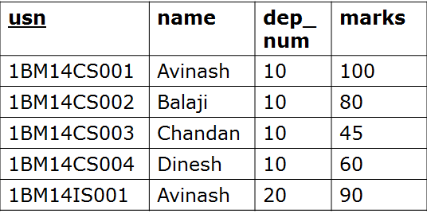
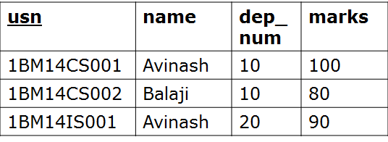
Select Operation (σ)
Select Operation (σ)
Returns all tuples which satisfy a condition
SQL:
σ_{selection condition}(R)
SELECT *
FROM Student
WHERE marks > 60;
Student
Equivalent
Relational Algebra
Expression

Slide 16

Select Operation (σ)
Select Operation (σ)
Returns all tuples which satisfy a condition
SQL:
σ_{selection condition}(R)
SELECT *
FROM Student
WHERE marks > 60;
Student
Relational Algebra Expression

Slide 17

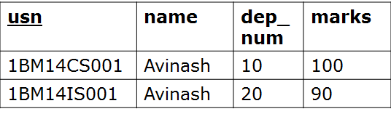
Select Operation (σ)
Select Operation (σ)
Returns all tuples which satisfy a condition
SQL:
σ_{selection condition}(R)
SELECT *
FROM Student
WHERE name=‘Avinash’;
Student
Relational Algebra Expression

Slide 18
Project Operation (∏ phi)
It projects column(s) that satisfy a given predicate.
Written as
Notation ∏_{A1,…., An} (R)
Where A₁, A₂ , A_{n} are attribute names of relation R.
Duplicate rows are automatically eliminated, as relation is a set.

Slide 19

Project Operation (∏ phi)
Eliminates columns, then removes duplicates
Written as
Notation ∏_{A1,…., An} (R)
SQL:
SELECT DISTINCT
dep_num
FROM Student;
Student
Relational Algebra Expression
dep_num
10
20

Slide 20

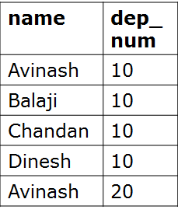
Project Operation (∏ phi)
Eliminates columns, then removes duplicates
Written as
Notation ∏_{A1,…., An} (R)
SQL:
SELECT DISTINCT
name, dep_num
FROM Student;
Student
Relational Algebra Expression

Slide 21
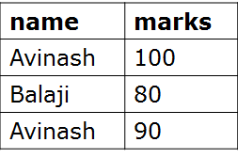
Note that RA Operators are Compositional!
Student
SELECT DISTINCT
name, marks
FROM Student
WHERE marks > 60;
How do we represent this query in Relational Algebra?

Slide 22

Note that RA Operators are Compositional!
Student
SELECT DISTINCT
name, marks
FROM Student
WHERE marks > 60;
How do we represent this query in Relational Algebra?

Slide 23

Note that RA Operators are Compositional!
Student
SELECT DISTINCT
name, marks
FROM Student
WHERE marks > 60;
How do we represent this query in Relational Algebra?
Are these logically equivalent?
Notes:
Result relation can be the input for another relational algebra operation! (Operator composition.)

Slide 24
Note that RA Operators are Compositional!
Student
SELECT DISTINCT
name, marks
FROM Student
WHERE marks > 60;
How do we represent this query in Relational Algebra?
Are these logically equivalent?
Notes:
Result relation can be the input for another relational algebra operation! (Operator composition.)

Slide 25
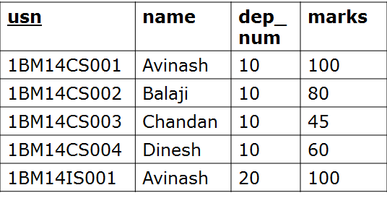

Question
Student
What is the output of following
relational algebra query ?
SELECT DISTINCT
name, marks
FROM Student
WHERE marks > 60;

Slide 26
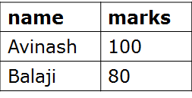
Question
Student
What is the output of following
relational algebra query ?
SELECT DISTINCT
name, marks
FROM Student
WHERE marks > 60;

Slide 27

Question
Student
What is the output of following
relational algebra query ?
SELECT DISTINCT
usn, name, marks
FROM Student
WHERE marks > 60;

Slide 28
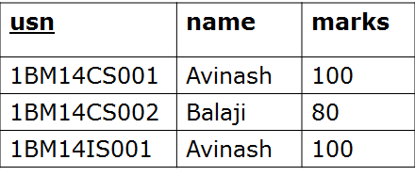
Question
Student
What is the output of following
relational algebra query ?
SELECT DISTINCT
usn, name, marks
FROM Student
WHERE marks > 60;

Slide 29

Question
Consider the relational schema Schedule containing Theater name, Movie Title and timing at which movie will be played. Time in the Schedule table is stored in 24Hr format i.e., 6:00pm will be stored as 18:00
Schedule(Theater, MovieTitle, Time)
Write the following query both in Relational Algebra and SQL.
List the theater name and time where we can watch the movie “FndingNemo" after 3pm.

Slide 30
Question
Consider the relational schema Schedule containing Theater name, Movie Title and timing at which movie will be played. Time in the Schedule table is stored in 24Hr format i.e., 6:00pm will be stored as 18:00
Schedule(Theater, MovieTitle, Time)
Write the following query both in Relational Algebra and SQL.
List the theater name and time where we can watch the movie “FndingNemo" after 3pm.
SELECT Theater, Time
FROM Schedule
WHERE MovieTitle = ’FindingNemo’ AND time >= 15:00;

Slide 31
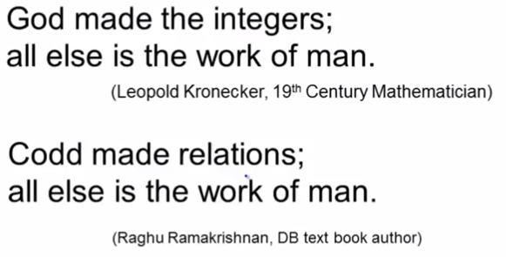
Database Philosophy
Won Turing award 1981
Edgar Ted Codd

Slide 32
Rename Operation (ρ rho)
The rename operation allows us to rename the either relation name or attribute names or both.
Written as
Notation
ρ_{S(B1,…., Bn)} (R) or ρ_{S}(R) or ρ_{(B1,…., Bn)} (R)
S is the new relation name and B₁, B₂….B_{n} are new attribute names.

Slide 33
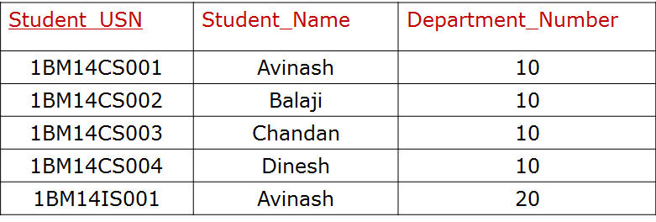
Rename Operation (ρ rho)
SQL:
The rename operation allows us to rename the either relation name or attribute names or both.
Student
SELECT
usn as Student_USN
name as Student_Name
dep_num as Department_Number
FROM Student;
ρStudent_USN, Student_Name, Department_Number (Student)
Student

Slide 34
Binary Operations

Slide 35



The CARTESIAN PRODUCT or CROSS JOIN returns the Cartesian product of the sets of records from the two or more joined tables.
Notation: table1 × table2
table1
table2
ID | M
1 | a
2 | b
4 | c
ID | N
2 | p
3 | q
5 | r
Relational Algebra Expression
table1 x table2

Slide 36

Join Operation
Written as R ⋈_{joincondition} S
Emp_Dept
Dept
Emp_ID | D_ID
121 | 2
240 | 4
D_num | D_name
1 | Sale
2 | Account
4 | Marketing
Emp_Dept ⋈_{D_ID=D_num} Dept
Emp_ID | D_ID | D_num | D_name
121 | 2 | 2 | Account
240 | 4 | 4 | Marketing

Slide 37
Join Written as R ⋈_{joincondition} S
JOIN operation is used to combine related records from two tables into a single records
A general join condition is of the form
<condition> AND <condition> AND……AND <condition>
Where each condition is of the form A_{i} θ B_{j} , A_{i} is an attribute in relation R and B_{j} is an attribute in relation S, Ai and Bj have same domain
It is called a theta join, if θ is one of the comparison operators {< , > , = , ≠ , ≤ , ≥}.
Once again, if θ is = it's called an equijoin, and
if the equijoin is on same-named attributes it's called a natural join and written as *.
Similarly, there are left, right, and full outer joins; written as ⟕, ⟖, and ⟗ respectively.

Slide 38
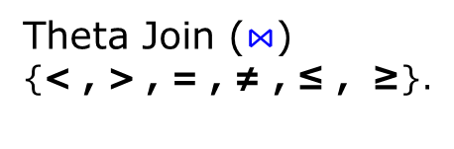

Join Operations
Join
Inner Join
Outer Join
Left Outer Join ⟕
Right Outer Join ⟖
Natural Join(*) (common attribute
names and domain
should exist between
two tables)
Full Outer Join ⟗

Slide 39
Equi Join
table1
table2
num | M
1 | a
2 | b
4 | c
ID | N
2 | p
3 | q
5 | r
num | M | ID | N
2 | b | 2 | p
Select *
From table1, table 2
Where num=id;
What is the equivalent
relational algebra expression ?

Slide 40
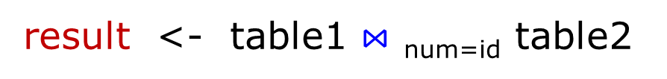
Equi Join
Select *
From table1, table 2
Where num=id;
table1
table2
num | M
1 | a
2 | b
4 | c
ID | N
2 | p
3 | q
5 | r
num | M | ID | N
2 | b | 2 | p
result
num | M | ID | N
2 | b | 2 | p

Slide 41
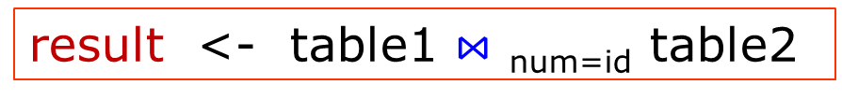
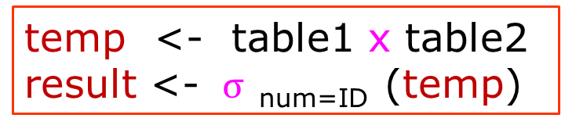
Question
table1
table2
result
num | M
1 | a
2 | b
4 | c
ID | N
2 | p
3 | q
5 | r
num | M | ID | N
2 | b | 2 | p
Are these logically equivalent?

Slide 42
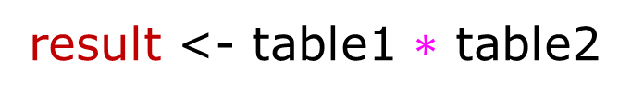
Natural Join
table1
table2
ID | M
1 | a
2 | b
4 | c
ID | N
2 | p
3 | q
5 | r
result
ID | M | N
2 | b | p

Slide 43
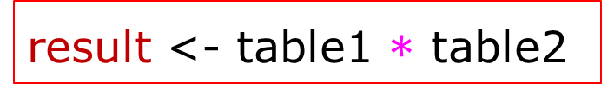
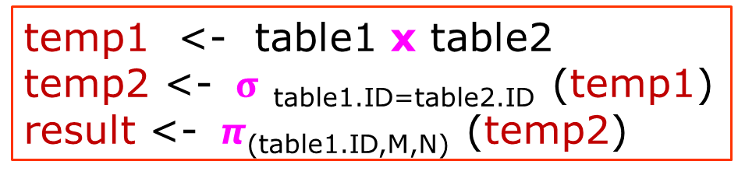
Question
table1
table2
result
ID | M
1 | a
2 | b
4 | c
ID | N
2 | p
3 | q
5 | r
ID | M | N
2 | b | p
Are these logically equivalent?

Slide 44
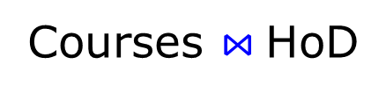
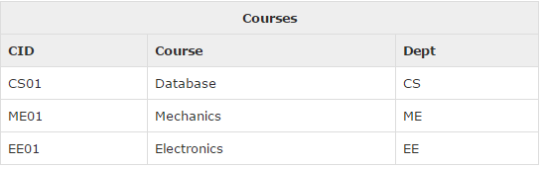
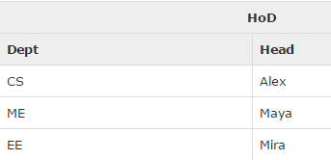
What will be the output of following Relational Algebra Expression

Slide 45
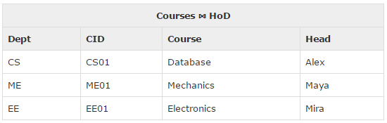
What will be the output of following Relational Algebra Expression

Slide 46
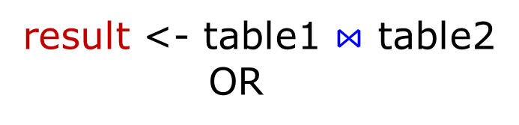
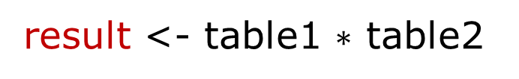
Natural Join
table1
table2
ID | M
1 | a
2 | b
4 | c
ID | N
2 | p
3 | q
5 | r
result
ID | M | N
2 | b | p
Natural join does not use any comparison operator. It does not
concatenate the way a Cartesian product does. We can perform a
Natural Join only if there is at least one common attribute that exists
between two relations. In addition, the attributes must have the same
name and domain. Natural join acts on those matching attributes
where the values of attributes in both the relations are same.

Slide 47
Problem to solve
Consider three tables
SAILORS(Sal_ID, SalName, Rating, Age)
RESERVES(Sal_ID , Boat-ID, Rdate)
BOATS(Boat-ID, BoatName, Color)
Write Relational Algebra express for the following
Find all the names of Sailors who have reserved boat with ID 2
Find names of sialors who have reserved RED boat
Find the colors of the boat reserved by Avinash

Slide 48
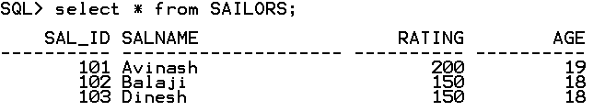
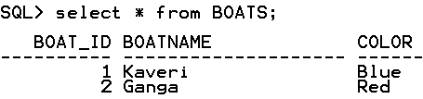
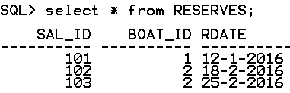
Problem to solve

Slide 49
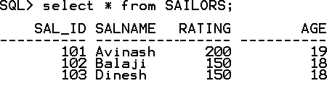
Problem to solve
Consider three tables
SAILORS(Sal_ID, SalName, Rating, Age)
RESERVES(Sal_ID , Boat-ID, Rdate)
BOATS(Boat-ID, BoatName, Color)
Write Relational Algebra express for the following
Find all the names of Sailors who have reserved boat with ID 2
OUTPUT
--------
Balaji
Dinesh

Slide 50

Problem to solve
Consider three tables
SAILORS(Sal_ID, SalName, Rating, Age)
RESERVES(Sal_ID , Boat-ID, Rdate)
BOATS(Boat-ID, BoatName, Color)
Write Relational Algebra express for the following
Find all the names of Sailors who have reserved boat with ID 2
temp1 <- σ_{Boat_ID=2} ^{(RESERVES)}
SELECT *
FROM RESERVES
WHERE Boat_ID = 2;
temp1

Slide 51

Problem to solve
Consider three tables
SAILORS(Sal_ID, SalName, Rating, Age)
RESERVES(Sal_ID , Boat-ID, Rdate)
BOATS(Boat-ID, BoatName, Color)
Write Relational Algebra express for the following
Find all the names of Sailors who have reserved boat with ID 2
temp1 <- σ_{Boat_ID=2} ^{(RESERVES)}
temp2 <- 𝞹_{SAL_ID}(temp1)
SELECT SAIL_ID
FROM RESERVES
WHERE Boat_ID = 2;
temp2

Slide 52

Problem to solve
i. Find all the names of Sailors who have reserved boat with ID 2
temp1 <- σ_{Boat_ID=2} ^{(RESERVES)}
temp2 <- 𝞹_{SAL_ID}(temp1)
temp3 <- SAILORS ⋈ SAILORS.Sal_ID=temp2.Sal_ID (temp2)
SELECT *
FROM SAILORS
NATURAL JOIN
(SELECT SAL_ID
FROM RESERVES
WHERE Boat_ID = 2);
temp3

Slide 53

Problem to solve
i. Find all the names of Sailors who have reserved boat with ID 2
temp1 <- σ_{Boat_ID=2} ^{(RESERVES)}
temp2 <- 𝞹_{SAL_ID}(temp1)
temp3 <- SAILORS ⋈ SAILORS.Sal_ID=temp2.Sal_ID (temp2)
result <- 𝞹_{SAL_Name}^{(temp3)}
result
SELECT SalName
FROM SAILORS
NATURAL JOIN
(SELECT SAL_ID
FROM RESERVES
WHERE Boat_ID = 2);

Slide 54
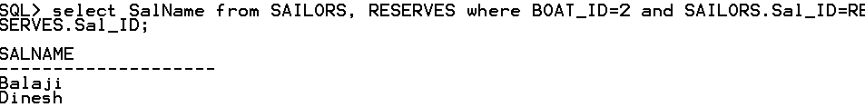
Problem to solve
i. Find all the names of Sailors who have reserved boat with ID 2
temp1 <- σ_{Boat_ID=2} ^{(RESERVES)}
temp2 <- 𝞹_{SAL_ID}(temp1)
temp3 <- SAILORS ⋈ SAILORS.Sal_ID=temp2.Sal_ID (temp2)
result <- 𝞹_{SAL_Name}^{(temp3)}

Slide 55
SAILORS(Sal_ID, SalName, Rating, Age), RESERVES(Sal_ID , Boat-ID, Rdate), BOATS(Boat-ID, BoatName, Color)
Write Relational Algebra express for the following
ii. Find names of sailors who have reserved RED boat
OUTPUT
--------
Balaji
Dinesh

Slide 56
SAILORS(Sal_ID, SalName, Rating, Age), RESERVES(Sal_ID , Boat-ID, Rdate), BOATS(Boat-ID, BoatName, Color)
Write Relational Algebra express for the following
ii. Find the colors of the boat reserved by Avinash
OUTPUT
--------
Red

